Slide 1
Air Quality Project
Assignment 1: Welcome to R!

Slide 2
What is R?
“R is a language environment for statistical computing and graphics”
Strength in the ease of production of publication-ready graphics and visuals
Learn more at r-project.org

Slide 3
Setup RStudio - BEFORE CLASS
Install R software.
Follow the instructions for download on: https://www.r-project.org/ Install R from a CRAN repository near your current location. After installation, an R Console might open – you may close this.
Install RStudio IDE – an environment for you to run, track, and output your R scripts.
Download the RStudio IDE Desktop here: https://rstudio.com/products/rstudio/.
Explanatory video at RStudio IDE Overview: https://www.rstudio.com/products/rstudio/?wvideo=520zbd3tij.
Notes:
Skippable if done before class

Slide 4
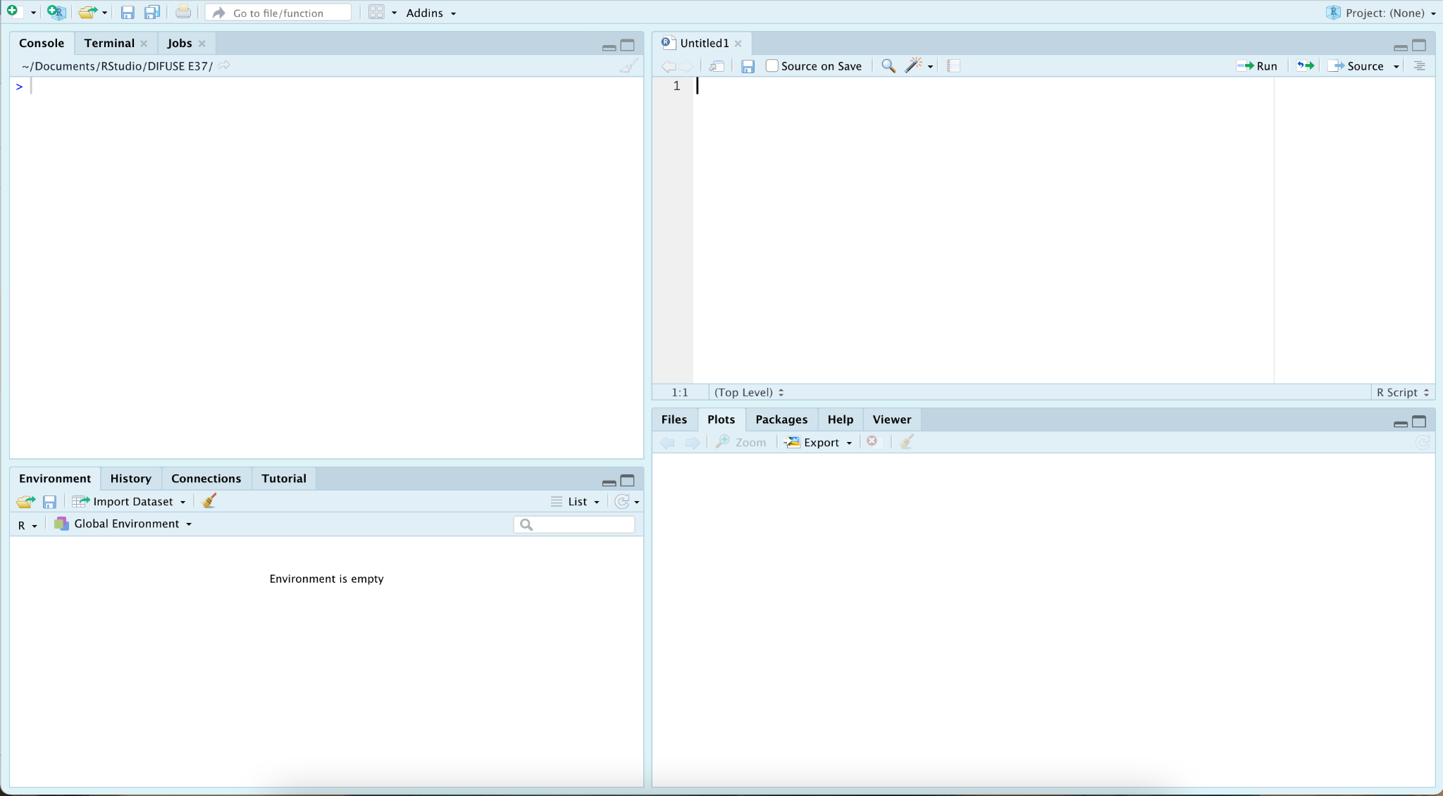
RStudio Startup
Open RStudio, you’ll see a few windows come up:
Console - run commands directly here
File Window - if you make a script, it will live in this corner
Environment - lists current objects (starts empty)
Viewer - view plots, files, packages, and help menus
Broomstick Icons clear that space

Slide 5
Helpful Commands #1
help.search("term") – where “term” is a word that might appear in the help files
? term – similar to above; for example: ? hist
help() – where you insert an R command in the (), like help(t.test)
summary(variable) – provides a summary of a particular variable
# – creates a comment line (#### after a comment makes that comment a “header”)
Let’s make sure our console works! Type the command: print(“Hello World!”) into the console and press enter.

Slide 6


Writing and Executing Code
Create an R Script file from File → New File → R Script, which will open a blank sheet/script, or click on ‘new file’ icon
Type in the script and pess or Cmd + Enter to execute code (Shift + Cmd + Enter will run the whole script)
Save your file as “R_intro_<first name>_<last name>.R” in a spot on your computer that you will remember. For example, if my name is Andrew Roznere, then I will save the file as R_intro_Andrew_Roznere.R

Slide 7
Load Data
R has some pre-saved data; we’ll use the data airquality.
Run this now from your new script to load the data directly: air_quality_data_full <- airquality
Note how the operation <- assigns the result of an operation (right side) to an object (left side). This is different from other coding languages that use “=”
If having trouble, download “R_intro_dataset.csv” from Canvas, then run air_quality_data_full <- read.csv(file.choose()). A window should pop up – navigate to the file “R_intro_dataset.csv” and select it.

Slide 8
Set Working Directory
We need to set our “working directory” for R to know where to look and save files.
Run the command getwd() in your Console to see what your current working directory is. What folder is R currently looking at (the last folder in the filepath)?
In your Documents directory (using Finder or Files Viewer, not RStudio), create a folder called “RStudio”. Within the “RStudio” folder, create another folder called “ENGS 37 Air Quality”.
In RStudio Console, run the command setwd() to set your working directory to end at the “ENGS 37 Air Quality” folder. Example on a macOS: setwd("Users/Andrew/Documents/RStudio/ENGS 37 Air Quality")
Folders are separated by forward slashes, and the order starts at a top level folder.

Slide 9
More About airquality
Today’s dataset was collected by the New York State Department of Conservation and the National Weather Service – contains daily readings (05/01/1973 – 09/30/1973)
Column # | Variable | Type | Name | Unit
1 | Ozone | integer | Ozone | ppb
2 | Solar.R | integer | Solar R | lang
3 | Wind | numeric | Wind | mph
4 | Temp | integer | Temperature | degrees F
5 | Month | integer | Month | 1–12
6 | Day | integer | Day of Month | 1–31
*Numeric value corresponds to a floating point value.
**For more detailed information on dataset, refer to: air quality dataset.

Slide 10
Viewing Data
There are several ways to view data. Run these one at a time and answer the corresponding questions on your answer sheet:
air_quality_data_full
colnames(air_quality_data_full)
str(air_quality_data_full)
head(air_quality_data_full)
length(air_quality_data_full$Ozone)

Slide 11
Cleaning Data
We only want to use Ozone and Month for our work today. Execute this line:
air_quality_data <- subset(air_quality_data_full, select=c(Ozone, Month)) # Selects only Ozone and Month
Fun tip: air_quality_data <- subset(air_quality_data_full, select=-c(Wind, Solar.R, Day, Temp)) # Can also select by telling R everything *not* to include

Slide 12
Verifying Data
We finally need to check that our cleaning process worked.
In the ‘Environment’ tab/window/panel, double-click on air_quality_data (your new subset). This will open up the data sheet in the Viewer panel.
In addition, what command(s) that you already learned can you use to show that you only have ozone and month now? Find one command that would also help you, run it, and record it on your answer sheet (hint: viewing data, Slide 9)

Slide 13
Data Analysis Process
You have completed the majority of the main process of data analysis in R! Next is to visualize and analyze the data.
You may repeat these steps several times to get the data you want now or do so again after your first or more analysis.
Load Data
Clean Data
Verify Clean
Visualize/ Analyze
Notes:
Skippable

Slide 14
Plot 1: Histogram
Let’s see what hist function can do for us: Execute help(hist)
Summarize what the arguments (breaks, main, xlab, ylab, xlim, and ylim) of the hist function are used for.
Create the default plot: hist(air_quality_data$Ozone)
Run the above command. Your plot will appear in the Plots panel. How many groups (bars) are there by default?
We will show you how to save your plot next.

Slide 15
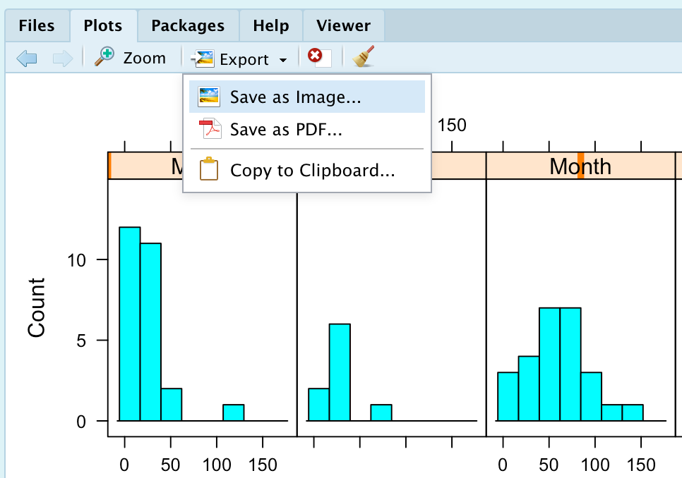
Saving Plots
In the ‘Plots’ window, either choose:
"Export/Save as Image..."
“Export/Save as PDF…”.
“Copy to Clipboard…”
Now you can save and paste your plot from hist(air_quality_data$Ozone) to your answer sheet.

Slide 16
Plot 1: Histogram (con’t)
This code includes an x-axis label, but deletes the graph’s title: hist(air_quality_data$Ozone, xlab="ppb", main="") hist(air_quality_data$Ozone, xlab="ug/L", main="")
Run both commands and paste your plots. What argument deleted the title?
To make the notation prettier: hist(air_quality_data$Ozone, xlab=expression(paste(mu, "g/", L)), main="") # Create the expression in the command
Run the command and paste your plot. What does the paste function do?

Slide 17
Plot 1: Histogram (con’t)
Change the number of bins in a histogram. R determines the number of bins (or breaks) to put in a histogram that makes it look "prettiest" using something called the Sturges method. Alternatively, you can tell R how many bins you would like it to create: hist(air_quality_data$Ozone, xlab="ppb", main="", breaks=22) hist(air_quality_data$Ozone, xlab="ppb", main="", breaks=5)
Choose a number of bins/breaks you think is most appropriate, paste that plot, and explain why that number is most appropriate.

Slide 18
Plot 1: Histogram (con’t)
Notice that you can change the look of the histogram by changing the range of values shown on the x-axis:
hist(air_quality_data$Ozone, xlab="ppb", main="", breaks=22, xlim=c(0, 200))
Choose an xlim that you think is best, explain why, and paste your plot.
Finally, playing around with all these options (and more that you find in the help documentation for hist()): create a plot that you think is best, paste it in your document, and describe the distribution you see.

Slide 19
Refining and Segmenting Data
What if we want to see the distribution of each month separately?
To create a histogram of Ozone for each month via a brute-force fashion, create subsets of the data for each month at a time. (You do not need to do this.)
hist(air_quality_data$Ozone[1:31], xlab="ppb", main="May") hist(air_quality_data$Ozone[32:61], xlab="ppb", main="June") hist(air_quality_data$Ozone[62:92], xlab="ppb", main="July") hist(air_quality_data$Ozone[93:123], xlab="ppb", main="August") hist(air_quality_data$Ozone[124:153], xlab="ppb", main="September")

Slide 20
Refining and Segmenting Data
What if we want to see the distribution of each month separately?
But it would be faster to use logical selection, e.g.:
hist(air_quality_data$Ozone[air_quality_data$Month==5], xlab="ppb", main="May")
Paste one plot for each month using logical selection and describe the distribution (i.e., shape, spread, outliers) of each month’s plot.
Also answer the additional questions on your answer sheet.

Slide 21
R Libraries
Next, let's try using a package to accomplish the same thing using a new library, lattice. But what is a library?
“R packages are a collection of R functions, compiled code and sample data. They are stored under a directory called "library" in the R environment. By default, R installs a set of packages during installation. More packages are added later, when they are needed for some specific purpose. When we start the R console, only the default packages are available by default. Other packages which are already installed have to be loaded explicitly to be used by the R program that is going to use them.” [source: https://www.tutorialspoint.com/r/r_packages.htm]
Notes:
Skippable, but nice to know

Slide 22
Installing and Loading lattice
Execute the following lines: install.packages("lattice") # install the library library(lattice) # Call/include the library IMPORTANT: After installing lattice, you will not have to install it again – but you will need to call it in your script via the library function to use its commands.

Slide 23
Segmenting with lattice
Summarize at least one similarity and one difference between the new histogram function and the old hist function.
? histogram # look at our new function
What do the x, data, and type arguments mean?
Execute the following lines one at a time:
histogram(~ Ozone | Month, data=air_quality_data) histogram(~ Ozone | Month, data=air_quality_data, type="count")
Notice the difference between the two histograms? Paste your plots and describe the differences.

Slide 24
Custom Graphics
What if you want to change the look of the graphic before putting it in your write-up? Let's build up a figure from scratch, and setting up graphical parameters ourselves. par(mfrow=c(5,1), mar=c(4,2,2,2)+0.01, oma=c(2,2,0,0)) #call ?par for more info hist(air_quality_data$Ozone[1:31], xlab="", main="May", xlim=c(0, 200)) hist(air_quality_data$Ozone[32:61], xlab="", main="June", xlim=c(0, 200)) hist(air_quality_data$Ozone[62:92], xlab="", main="July", xlim=c(0, 200)) hist(air_quality_data$Ozone[93:123], xlab="", main="August", xlim=c(0, 200)) hist(air_quality_data$Ozone[124:153], xlab="", main="September", xlim=c(0, 200)) mtext("ppb", 1, outer=TRUE, cex=1.5) mtext("Frequency", 2, outer=TRUE, cex=1.5) Paste the final plot and explain at least two pros and two cons of this plot compared to the earlier ones.
Notes:
Skippable (a lot of code to run)

Slide 25
Plot 2: Box Plots
Create box plots for the whole dataset and for each month. boxplot(air_quality_data$Ozone, xlab="ppb", main="") boxplot(air_quality_data$Ozone ~ air_quality_data$Month, xlab="ppb", ylab="Month", main="") If you are having trouble plotting the boxplot due to the previous par window formatting, run this before the boxplots: par(mfrow=c(1,1), mar=c(4,2,2,2)+0.01, oma=c(2,2,0,0))

Slide 26
Plot 2: Box Plots (con’t)
Paste your plots. Describe what you see in the box plots, and how this is similar/different from the histograms.
Which months are captured well by the histogram? By the boxplot? Which are captured poorly by either or both of these months? Is there a third option worth pursuing? A neat trick for boxplots: points(air_quality_data$Month, air_quality_data$Ozone, col="red", cex=0.5)

Slide 27
Numeric Summaries
Numeric summaries – mean & SD vs. 5-number summary – can be important for discussing the distribution of each variable, if appropriate. To calculate all of the numeric summaries by month: by(air_quality_data$Ozone, air_quality_data$Month, summary) Write the output in a table (see answer sheet), and highlight the row with the most potential for error. (Hint: What do the NAs in the data mean? Look at your data in a way that shows you the NAs to learn more.)

Slide 28
Cleaning 2: Removing NAs
At times, calls/functions might not work properly with your dataset as it includes NA’s. To clean or remove NA’s from datasets:
nas <- is.na(air_quality_data) # Returns a logical array of TRUEs where NAs are in the original set. New array is same size as data air_quality_data_cleaned <- air_quality_data[complete.cases(air_quality_data), ] # Note: we need the comma and space in the brackets to select all rows and columns to check
Check this cleaned up dataset – What is the number of the last row? Are there actually this many rows?

Slide 29
More Plots: ggplot and tidyverse
To install and load these libraries:
install.packages("tidyverse") install.packages("ggplot2") library(tidyverse) library(ggplot2) Go through each example on the next seven slides, paste your plot, and in one sentence describe the possible purpose of designing such a plot.
Notes:
All seven of these can be skipped (easy to do on their own)

Slide 30
ggplot and tidyverse: Plot 1
qplot(air_quality_data$Ozone, geom = "histogram", # graph type binwidth = 3, # bin size main = "Histogram of Ozone", # figure title xlab = "ppb", # label for x axis fill = I("green"), # fill color col = I("black"), # outline color alpha = I(.5), # fill transparency (between 0-see through and 1-opaque) xlim = c(0, 200)) # x axis range
Notes:
skippable

Slide 31
ggplot and tidyverse: Plot 2
ggplot(data = air_quality_data, aes(air_quality_data$Ozone)) + geom_histogram(breaks = seq(0, 200, by = 3), col = "black", aes(fill = ..count..)) + scale_fill_gradient("Count", low = "green", high = "red") + labs(title = "Histogram of Ozone", x = "ppb", y = "Count")
Notes:
skippable

Slide 32
ggplot and tidyverse: Plot 3
multi <- air_quality_data %>% #tidyverse's "piping" functionality with "%>%" ggplot(aes(x = Ozone, color = Month, fill = Month)) + geom_histogram(alpha = 0.5, binwidth = 3) + theme(legend.position = "none") + xlab("") + ylab("ppb") + facet_wrap(~Month)
multi
Notes:
skippable

Slide 33
ggplot and tidyverse: Plot 4
outliboxplot <- air_quality_data %>% ggplot(aes(x = Month, y = Ozone, fill = Month)) + geom_boxplot(outlier.color = "black", outlier.shape = 8, outlier.size = 2) + # outlier boxplot stat_summary(fun = mean, geom = "point", shape = 23, size = 4) # add mean diamond outliboxplot
Notes:
skippable

Slide 34
ggplot and tidyverse: Plot 5
dotnboxplot <- air_quality_data %>% ggplot(aes(x = Month, y = Ozone)) + geom_boxplot() + geom_jitter(color = "black", size = 0.9, alpha = 0.8) + theme(panel.border = element_blank(), panel.background = element_blank(), panel.grid.major = element_blank(), panel.grid.minor = element_blank(), axis.line = element_line(color = "black")) dotnboxplot
Notes:
skippable

Slide 35
ggplot and tidyverse: Plot 6
Make sure your NAs are removed before running this:
air_quality_data_cleaned %>% group_by(Month) %>% summarise(count = n(), df = count-1, mean = mean(Ozone), sd = sd(Ozone))
Notes:
skippable

Slide 36
ggplot and tidyverse: Plot 7
Make sure your NAs are removed before running this:
air_quality_data_cleaned %>% group_by(Month) %>% summarise(count = n(), df = count-1, min = min(Ozone), Q1 = quantile(Ozone, 0.25), M = median(Ozone), Q3 = quantile(Ozone, 0.75), max = max(Ozone))
Notes:
skippable

Slide 37
Final Plot: Your Choice!
Finally, create a figure (possibly with multiple panels) comparing the distributions, this time, of Wind or Temperature. The exact nature of the figure is up to you; if you have multiple panels, just be sure to label the separate panels. You should also be sure to include descriptions of the distribution (i.e., shape, spread, outliers) of each month or note any observations of the data that you had.
Ask your peers/TAs/Prof Taylor for help if needed.
Notes:
Skippable, also can be done on own

